Slide 1
In The Dark

Slide 2
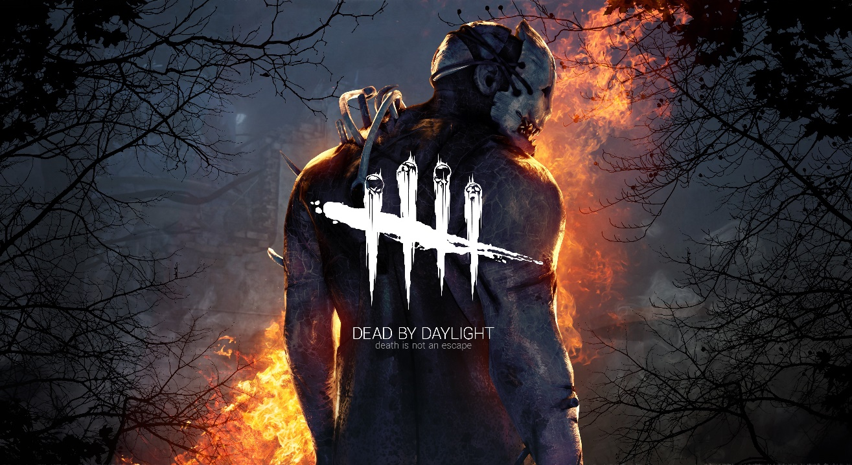
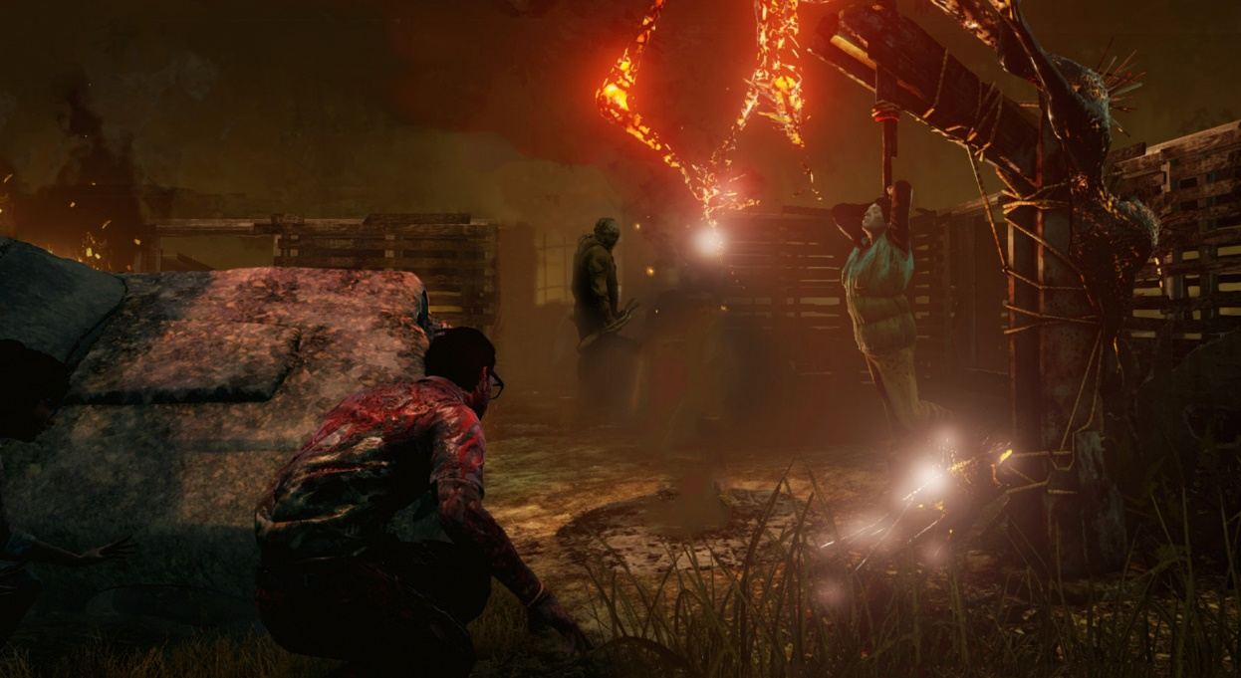
Inspiration – Dead By Daylight
“In The Dark” was inspired by “Dead By Daylight” as the ideas and themes are similar:
4 survivors vs 1 killer
Survivors: Escape!
Killer: Kill them all!
Survivor and Killer bonuses and perks
Engines, Traps, Exits, Barricades

Slide 3
Trailer
https://youtu.be/ZXuw7KwA0qU

Slide 4
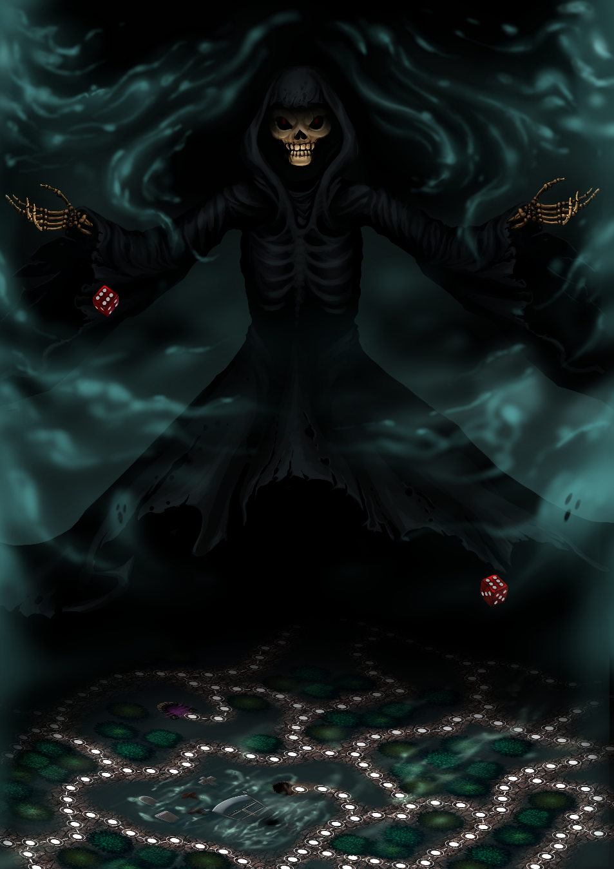
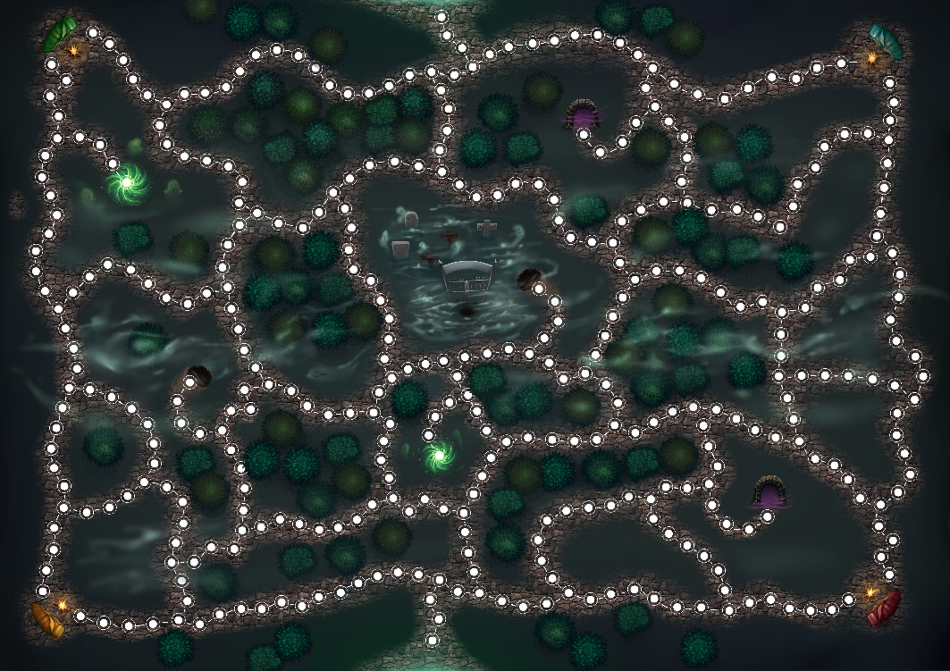
Differences to Dead By Daylight
Turn-Based Board Game
Introduction of tunnels – which transport survivors across the map.
Perks and Bonuses are represented by Cards
Dead By Daylight is Hide & Seek – In The Dark is Tag

Slide 5
Basic Rules and objectives
Survivors
Reaper
Moves with 2 dice.
Receives a bonus card at the start.
Step on an engine and repair it by stacking steps on them.
Repair all generators to open the exits and escape.
Step on chests and receive cards with bonuses.
Step on traps and get stunned for a turn.
Travel through a tunnel to move quickly around the map.
Always move with 2 dice.
Receive up to 2 bonus cards at the start.
Step on a survivor, stop and hit them once.
When hit a survivor can only move with one die until he heals himself.
Hit a survivor twice to kill them.
Kill them all! Let none escape!

Slide 6

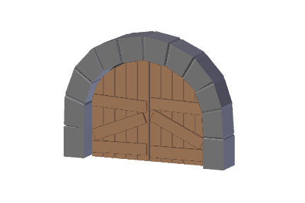
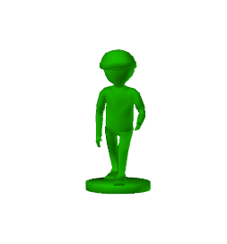
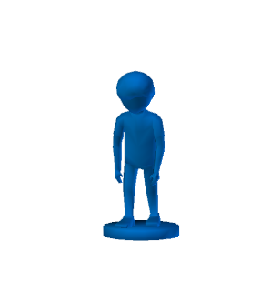

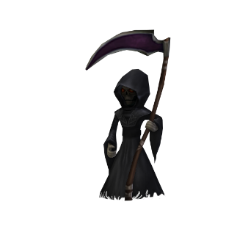
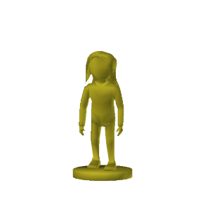
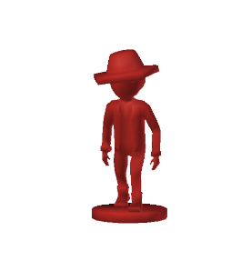
Turn 0

Slide 7
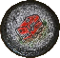

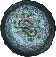
Turn 2

Slide 8
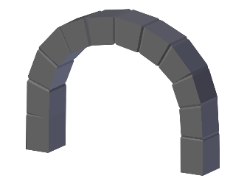
Turn 47

Slide 9

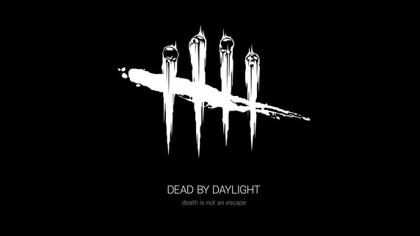

Development
Version 0.0
Concept phase :(
“Star Wars” Podracing -> “Heroes of Might & Magic” -> “Dead By Daylight”
Hexagonal board for true but easy-to manipulate randomness – scrapped
“Game with no name yet” is advanced Tag
Moodboard with “Dead By Daylight” imagery
Tried to figure out a name with no success for a while

Slide 10
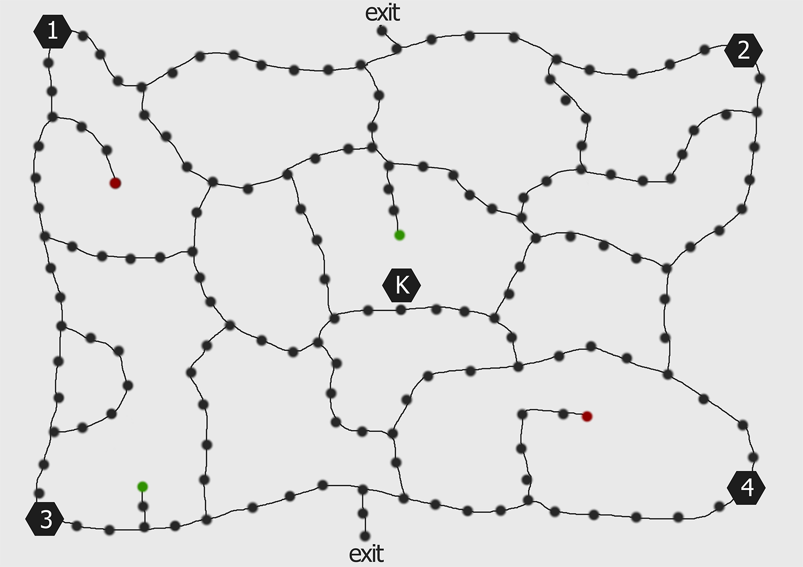
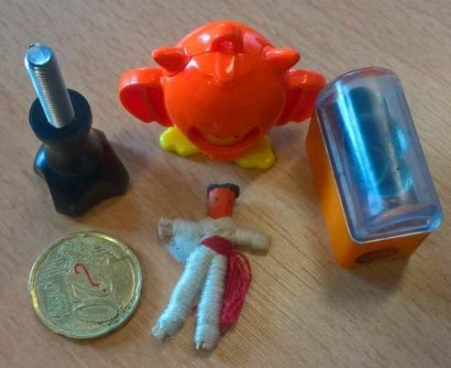
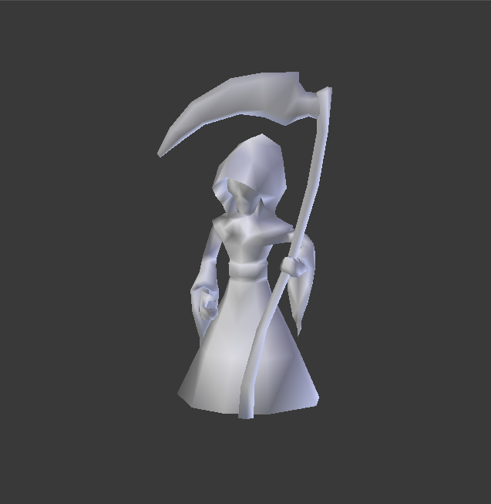
Development
Version 0.1
Fixed map layout
Idea of cards with bonuses
Created a rulebook to be changed while playtesting
A4 version of the board
Very “alpha” pawns
Dice apps
Discussion
Playtesting!
New Rulings!
First 3D Model!
“Reapers Creepers” *shrugs*

Slide 11
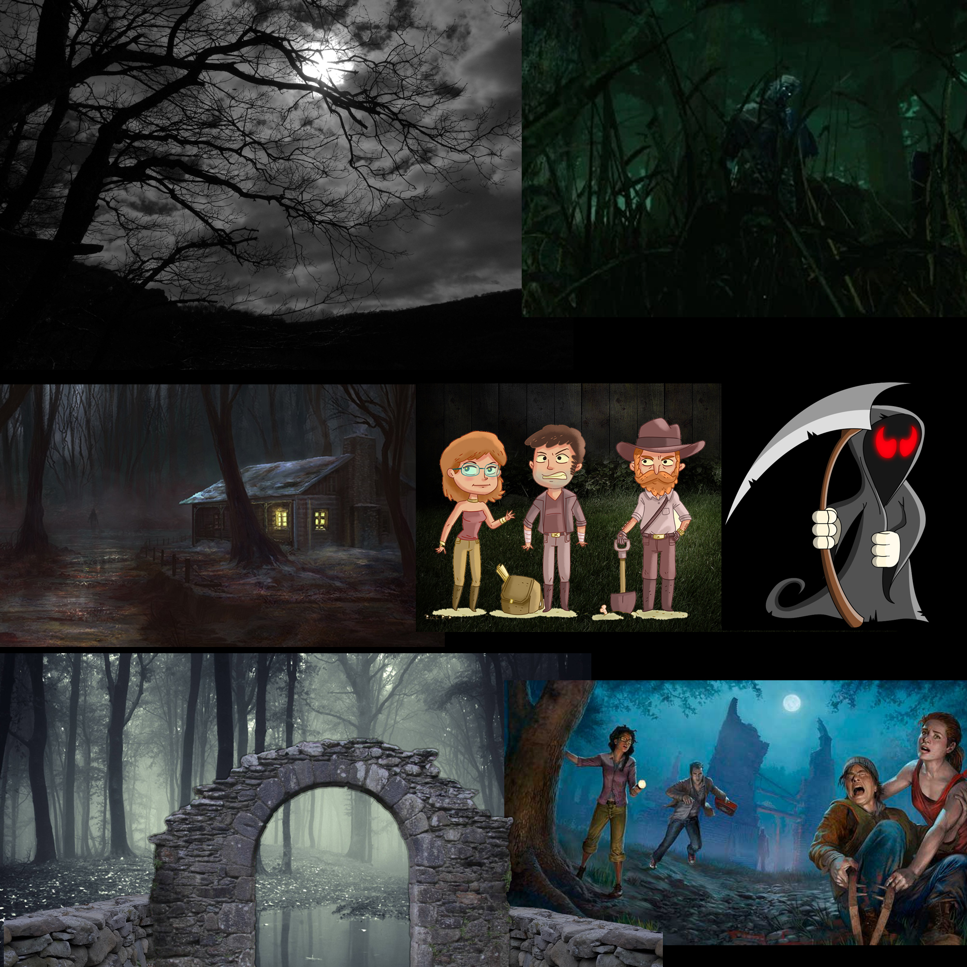
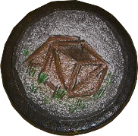
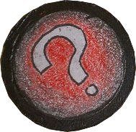
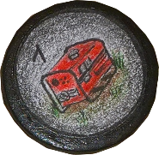
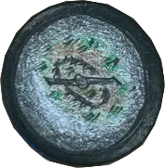
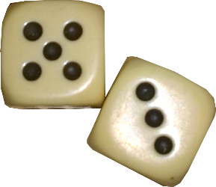
Development
IN THE DARK
Version 0.2
Dice and Tokens!
Game Design Document (Documentation) :(
Card and Map Design
New moodboard
A2 map (out of A4s)
“In The Dark”
More playtesting and rules

Slide 12
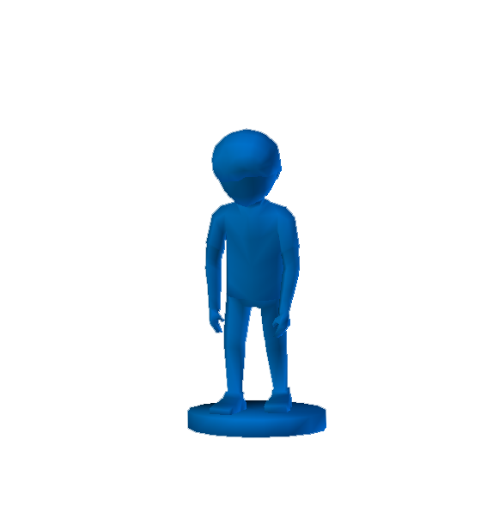
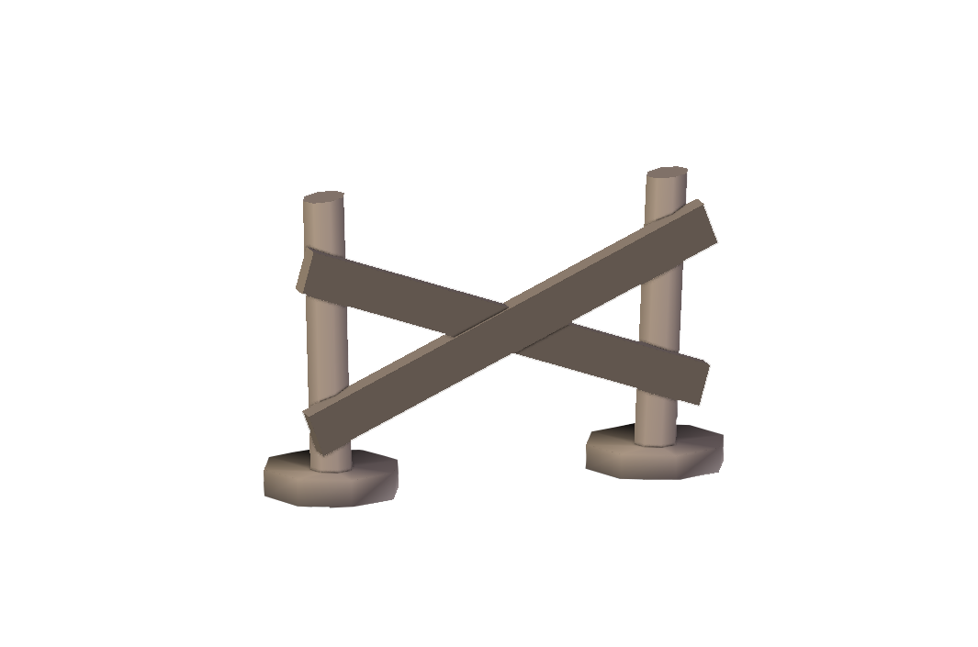
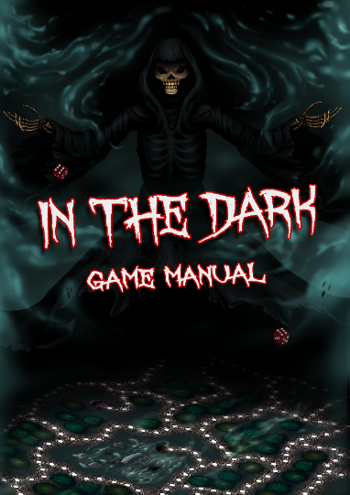
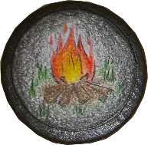
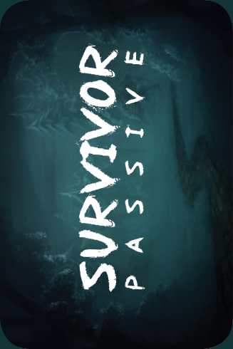
Development
Interim
Map, card, game manual and poster design done
3D Models not fit for printing x2
3D Models started printing
Rulebook balancing
Trailer Script
New Box
New Game Board
Pawn, figurine and box painting
Map, poster, game manual and card printing
Trailer Footage
Trailer Editing
Campfire Token!

Slide 13
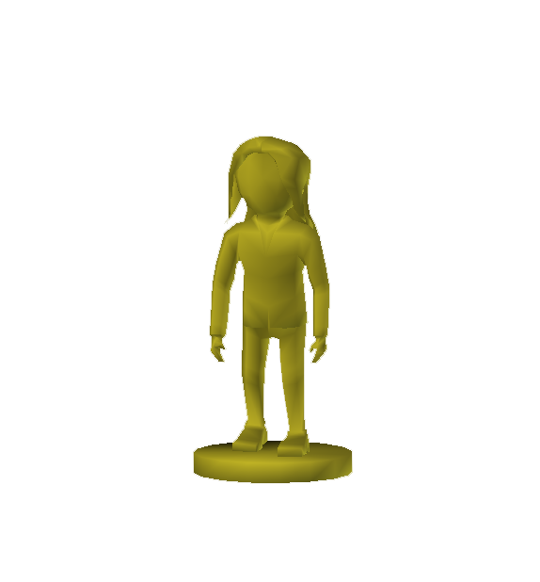
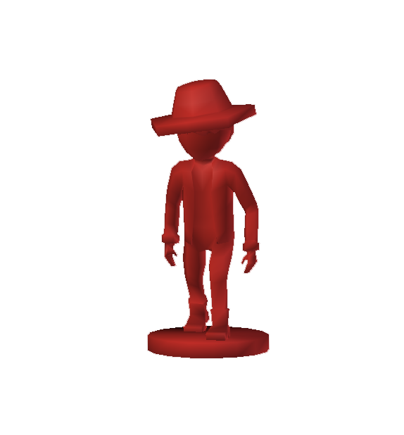

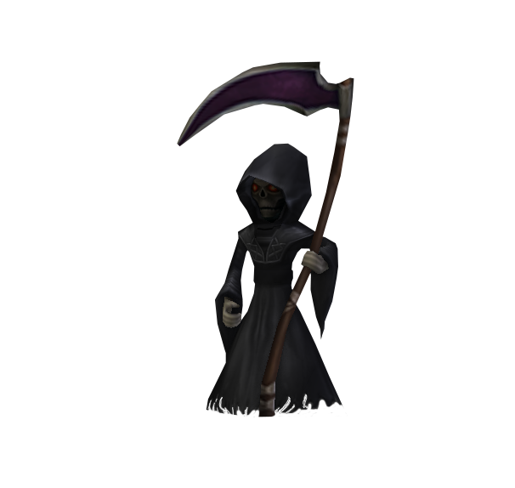
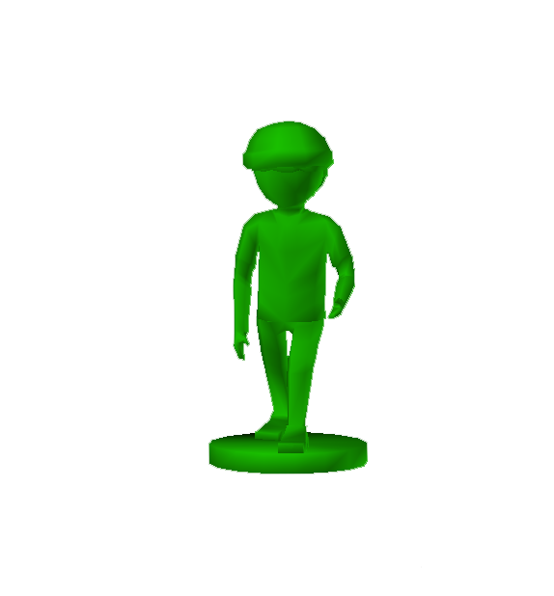
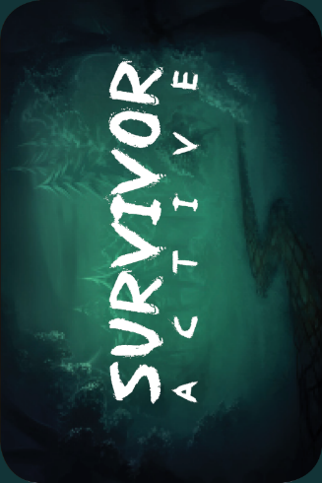
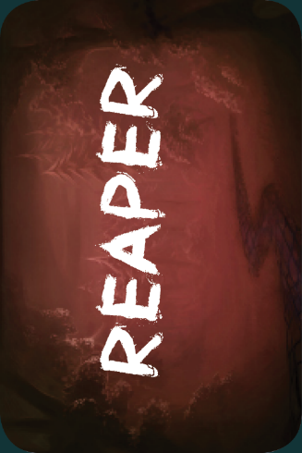
Contents Of Version 1.0

Slide 14
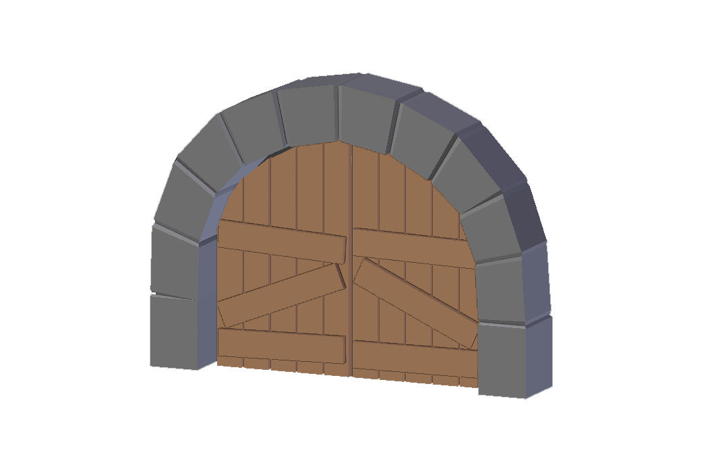
What Tim Did
3D Model Creation
3D Printing
Mood board
Team Planning
Map Layout
Trailer Footage
Provided Pawns, Figurines and Laminated Cards
Playtesting

Slide 15
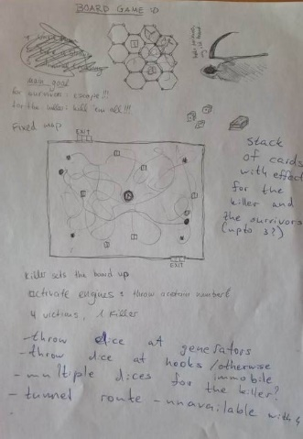
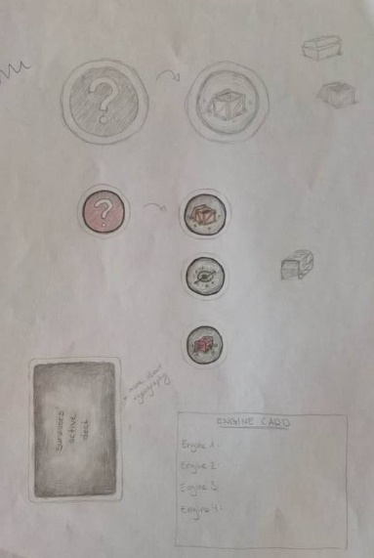
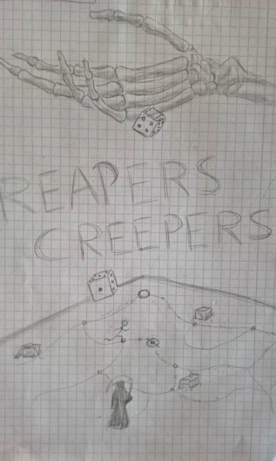
What Mathilde Did
Concept Art
Tokens
Original Idea for “Dead By Daylight”
Team Planning
Provided the substitute pawns
Map Layout
Concept Art For The Poster
Playtesting
The Box

Slide 16

What Slavi Did
Rules
Card Effects
Balancing
Team Planning
Game Documentation
Trailer Script
This Presentation
Provided Box and Board
Playtesting
The Box

Slide 17
What Plamen Did
Rulebook
Card Effects
Balancing
Team Planning
The Other Presentation
Game Manual Design
Trailer Footage and Editing
Playtesting
The Box

Slide 18
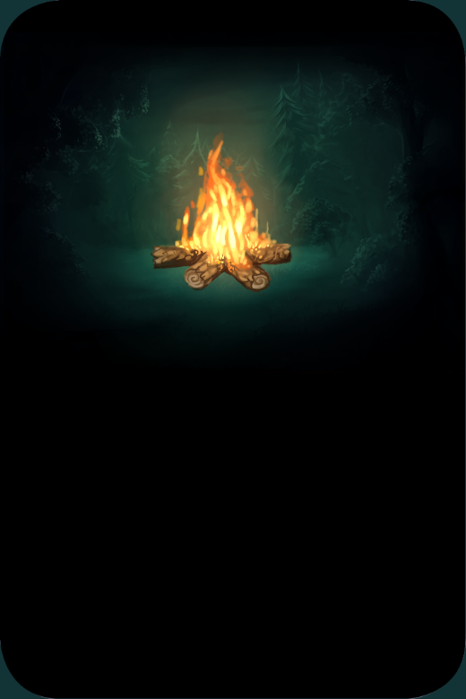
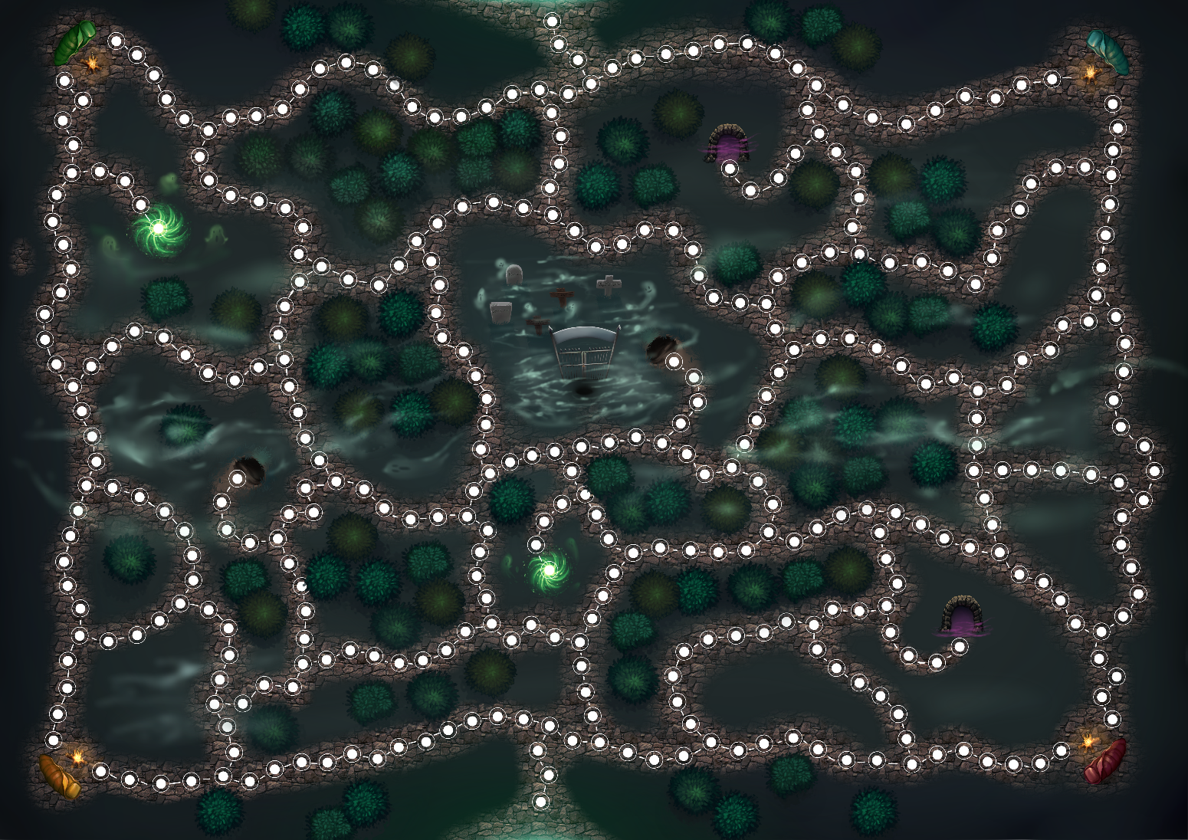

What Jacqueline Did
Map Design
Map Color
Team Planning
Card Design – Back and Front
Card Color – Back and Front
Poster
Playtesting

